Slide 1
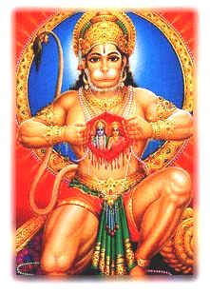
Hanuman Jayanthi

Slide 2
Why we celebrate Hanuman Jayanti?
Hanuman Jayanti is celebrated to commemorate the birth of Hanuman, the monkey god.
Hanuman is the symbol of strength and energy.
Hanuman is said to be able to assume any form at will, wield rocks, move mountains, dart through the air, seize the clouds and rival Garuda in swiftness of flight.

Slide 3
How we celebrate Hanuman Jayanthi
The devotees visit temples and apply tilak of sindhūr to their foreheads from the Hanuman’s body as this is considered to be good luck.
They sing Hanuman Chalisa and many sacred hymns

Slide 4
Virtues of Lord Hanuman
He was a great devotee of Lord Ram. He is the living embodiment of Ram-Nam.
Lord Hanuman was Knowledgeable.
He had the Spirit of selfless service. He served Sri Ram with pure love and devotion, without expecting any fruit in return. He lived to serve Sri Ram.
He had no desires. He never boasted of his bravery and intelligence. He was an ideal selfless worker, a true Karma Yogi who worked desirelessly and dynamically.
He was humble, brave and wise. He possessed all the divine virtues.
He did what others could not do such as crossing the ocean simply by uttering Ram-Nam, burning the city of Lanka, and bringing the Sanjeevani herb and restoring Lakshman to life again.

Slide 5
Hanumanji’s Popularity
Students pray to him for intelligence and soldiers for strength.
In olden days there used to be temples of Hanuman at the gates of forts.
The gymnasiums of wrestlers invariably have his picture.

Slide 6
Lord Ram’s Words for Hanuman
“I will always remain deeply indebted to you”
“I give you the boon of everlasting life”
“All will honor and worship you like Myself. Your Murti will be placed at the door of My temple and you will be worshipped and honored first”
“Whenever My stories are recited or glories sung, your glory will be sung before Mine”
“You will be able to do anything, even that which I will not be able to!"

Slide 7
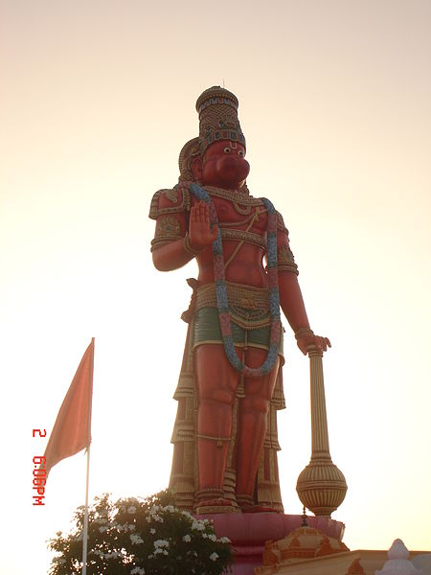
Why Hanuman’s Body is orange in Color ?
According to the legend Sita was applying sindhūr to her head, Hanuman Ji questioned why and she replied that this would ensure a long life for her husband. Hanuman then smeared his entire body with sindhūr, in an effort to ensure Rama’s immortality.

Slide 8
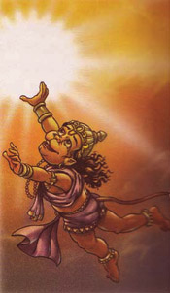
Hanuman Eating Sun
When he was still a child, his mother, Anjani, had assured him that he would never be destroyed and when he feels hungry he can have fruits as red and ripe as the rising sun. Thinking that the glowing sun was a ripe red fruit he mistook it as an apple and tried to grab it, at the speed of wind, in the sky and the severe heat of the SUN had no effect on him.

Slide 9
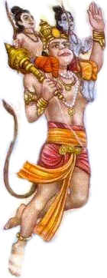
Hanuman takes Ram and Lakshman to Sugriva (monkey king)
Hanuman was a friend and servant of Monkey King Sugriva. On his request
he came to get the identity of the two strangers who were wondering in their plains
below the mountain, these strangers were Ram and Laxman. They were searching
for kidnapped Sita. Hanuman placed them on his shoulders and took them to
Sugriva on the mountain top.
Ram and Sugriva promised to help each other to find Sita. When Hanuman was searching for Sita he met Sampati who was brother of Jatayu. Jatayu was killed while he was trying to stop Sita from being kidnapped by Ravana. Sampati told Hanuman that he could see Sita being kept in Ashokvatika in Lanka.

Slide 10
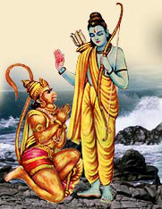
Hanuman becomes a great devotee of Sri Ram

Slide 11
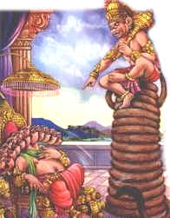
Hanuman makes his own throne in front of Ravan
When Hanuman Reached Lanka and met Ravana, Ravana did not offer Hanuman a chair to sit. Hence Hanuman created his own thorn by extending his tail long enough and then sitting in front of Ravana.
Ravana was shocked to see this and called his demons to set Hanuman's tail on fire. When Hanuman went to Lanka Ravana's soldiers tied Hanuman's tail with rags fabrics and Hanuman made the tail longer and longer. The exhausted demons set fire to his tail.
Now it was Hanuman's turn he jumped all over Lanka setting the entire city ablaze with his tail still on fire. In the fight between Ram and Ravana to free Sita, Ravana made an assault on Ram Seeing this, Hanuman, roving his club, came close to Ravana. To show the might of Hanuman, he did not hit Ravana with his "Gada", the Club, but gave a big blow with his free hand. Ravana's entire body and his ten heads were terribly shaken.

Slide 12
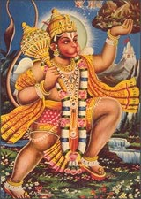
Hanuman carries Sanjivani Herb to save Lakshman
When the battle between Ravana and Ram was been fought Laxman got hit with an arrow and the vaidya (doctor) told Ram if Laxman smells a shrub called "Sanjivani" from the mountain "Gandhamadan" he will be alright. Hanuman went on the mountain but as he could not recognize the shrub Sanjivani, he uprooted the entire mountain and brought it to the doctor.

Slide 13
Sri Ram and Sita Devi’s image in Hanuman’s Heart
Hanuman, had a special place in the heart of Lord Rama.Hanuman's devotion to Ram was profound and everything and anything without Him seemed futile. Once, when Sita presented a pearl-necklace to him, he tried to find Ram in each pearl. But when disappointed he tore and threw it away.
She was surprised and asked for an explanation. In reply, Hanuman tore off his chest with his nails and showed everyone the word Ram engraved in his heart.
Even today the idol of Hanuman, god of protection, is found in the temples of Ram.

Slide 14
Backup

Slide 15
Birth of Hanuman
Vrihaspati had an attendant called Punjikasthala, who was cursed to assume the form of a female monkey — a curse that could only be nullified if she would give birth to an incarnation of Lord Shiva. Reborn as Anjana, she performed intense austerities to please Shiva, who finally granted her the boon that would cure her of the curse.
When Agni, the god of fire, gave Dasharath, the king of Ayodhya, a bowl of sacred dessert to share among his wives so they may have divine children, an eagle snatched a part of the pudding and dropped it where Anjana was meditating, and Pavana, the god of wind delivered the drop to her outstretched hands. After she took the divine dessert, she gave birth to Hanuman. Thus Lord Shiva incarnated as a monkey, and was born as Hanuman to Anjana, by the blessings of Pavana, who thus became Hanuman's godfather.
He was named Hanuman after the name of the city of Hanumpur over which his maternal uncle Parti Surya ruled. Hanuman's body was hard as a stone. So Anjani named him Vajranga. He is also known by the names "Mahavir" or mightiest hero (because he exhibited several heroic feats), Balibima and Maruti.

